Slide 1
CHAPTER 11 UNOBTRUSIVE RESEARCH

Slide 2
Unobtrusive Research
Methods of studying social behavior without affecting it.

Slide 3
Types of Unobtrusive Research
Content Analysis
Analysis of Existing Statistics

Slide 4
Content Analysis
The study of recorded human communications (e.g., books, newspapers, websites, paintings, laws).
“Who says what, to whom, why, how, and with what effect?”

Slide 5
Practice: Content Analysis of Violence on TV
What are your operational definitions?
What will you observe?
How will you analyze the data?

Slide 6
Content Analysis
Units of Analysis
Units vary based on interests
coding of materials can be more or less precise

Slide 7
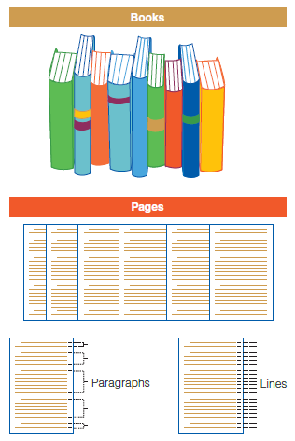
Figure 11-1
A Few Possible Units of Analysis for Content Analysis

Slide 8
Practice: Identifying Units of Analysis for Content Analysis Topics
You are interested in how children’s literature portrays gender roles.
You are interested in popular film’s use of drugs and alcohol.
You are interested in sociology textbooks’ definition of race.
You are interested in the content of Internet blogs.

Slide 9
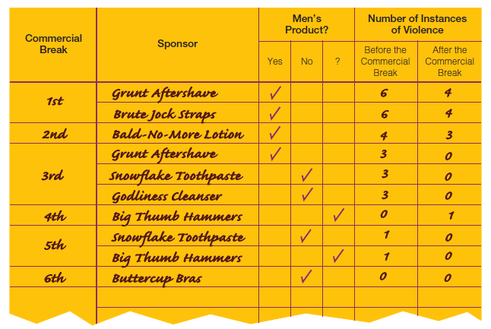
Figure 11-2
Example of Recording Sheet for TV Violence

Slide 10
Content Analysis
Sampling
Any conventional sampling technique may be used for content analysis.

Slide 11
Content Analysis
Coding
Transforming raw data into a standardized form for analysis.

Slide 12
Content Analysis
Manifest Coding
The concrete terms contained in a communication.
Latent Coding
The underlying meaning of communication.

Slide 13

Figure 11-3
Manifest Coding of Materials (Objective)
Manifest coding involves the counting of specific elements, such as the word love, to determine whether and to what degree the passage should be judged “romantic.”

Slide 14

Figure 11-3 (cont’d)
Latent Coding of Materials (Subjective)
Latent coding calls for the researcher to view the entire unit of analysis (a paragraph in this case) and make a subjective assessment regarding whether and to what degree it is “romantic.”

Slide 15
Content Analysis
Conceptualization and the Creation of Code Categories
Attributes
Levels of Measurement
Counting and Record Keeping
The end product of coding must be numerical.
Numerical coding needs a denominator.

Slide 16
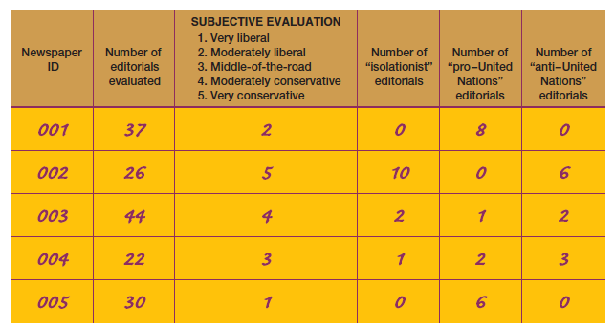
Figure 11-4
Sample Tally Sheet (Partial)

Slide 17
Content Analysis
Strengths of Content Analysis
Time and money
Correction of errors
Study of processes occurring over time
Research has virtually no effect on subjects
Reliability
Weaknesses of Content Analysis
Limited to recorded communications
Validity

Slide 18
Analyzing Existing Statistics (slide 1 of 4)
Existing statistics may be the main source of data or a supplemental source of data.
Example: Durkheim’s Study of Suicide

Slide 19
Analyzing Existing Statistics (slide 2 of 4)
Units of Analysis
By nature, existing statistics describe groups.
Ecological Fallacy

Slide 20
Analyzing Existing Statistics (slide 4 of 4)
Sources of Existing Statistics
Statistical Abstract of the United States
Government Data/Census
Demographic Yearbook

Slide 21
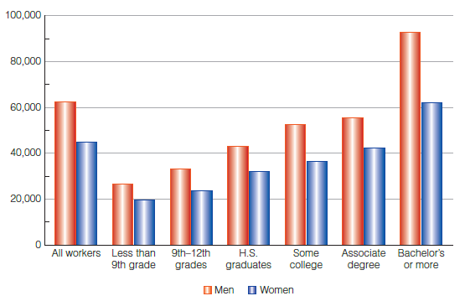
Figure 11-5
Graphic Display of Gender, Education, and Income

